Slide 1
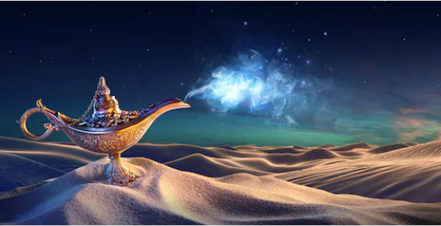
Arabian Nights - Arabian Days Summer 2020

Slide 2
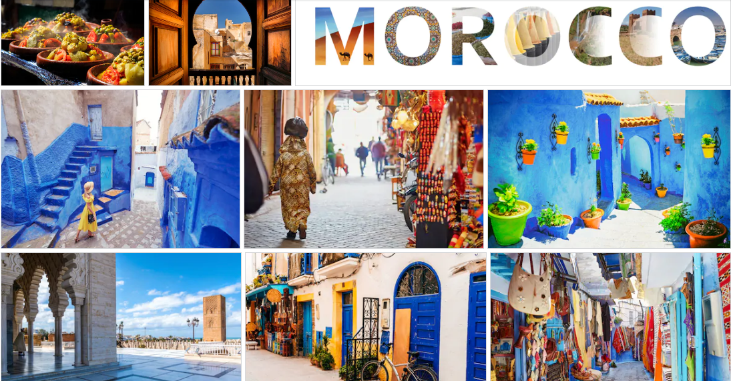
Notes:
Cosmopolitan mix of European and Arabian essences.
Unique blend of cultures, religions, languages, traditions and identities
History and Modernism live together on the coastal connection between the Atlantic Ocean and the Mediterranean Sea.
A fascinating place to live and learn during the summer.

Slide 3
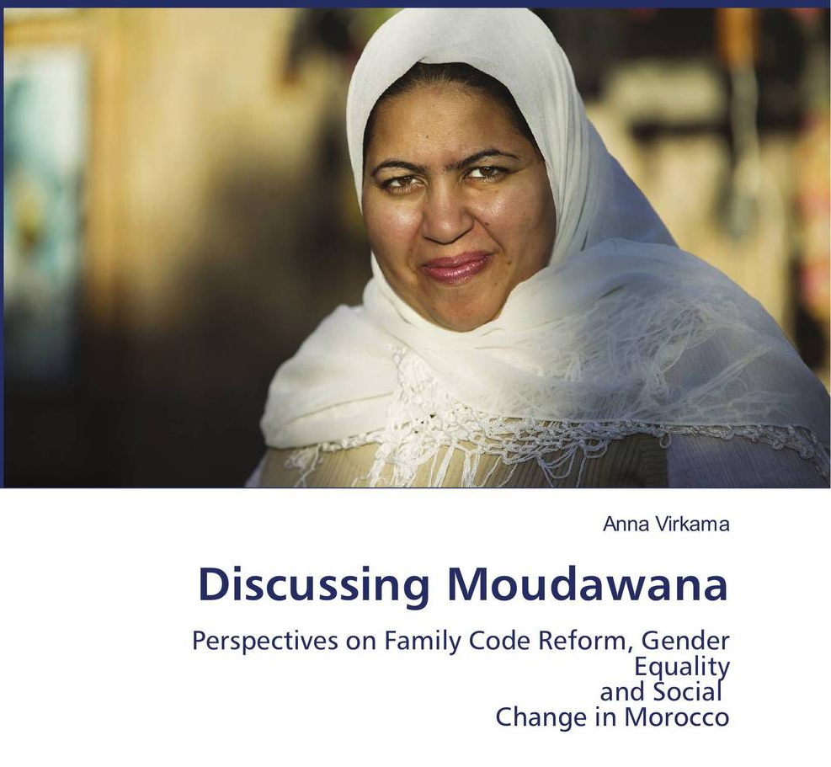
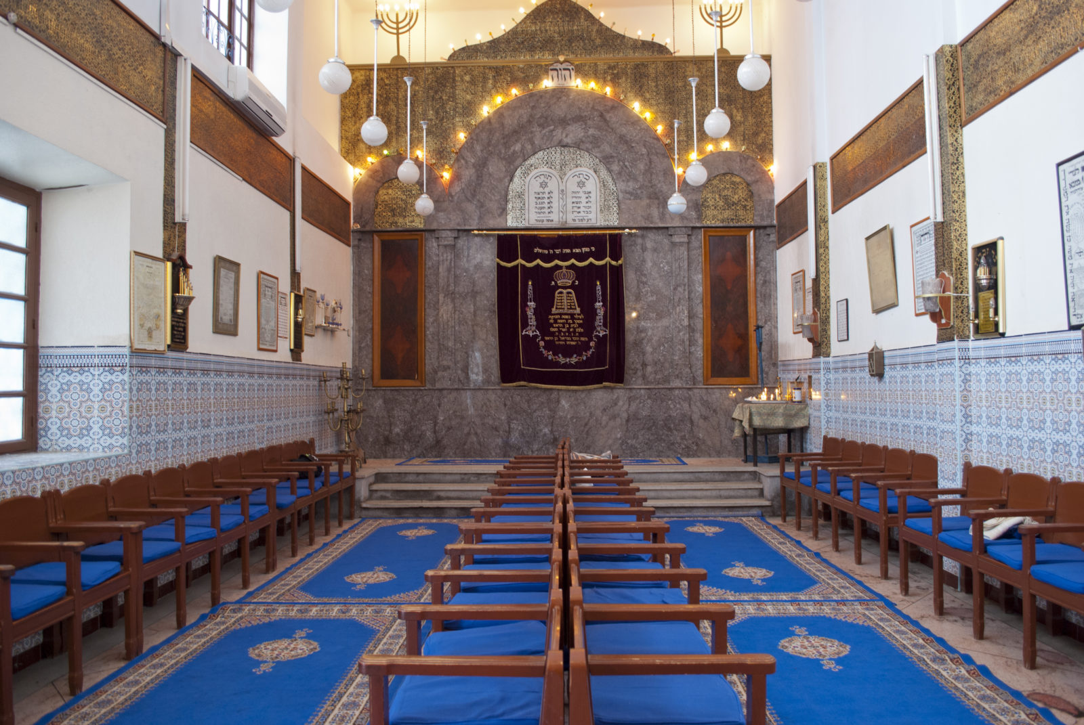
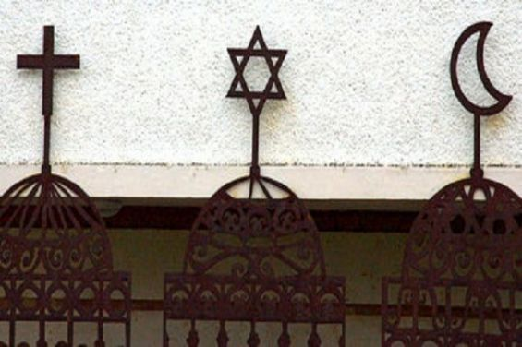
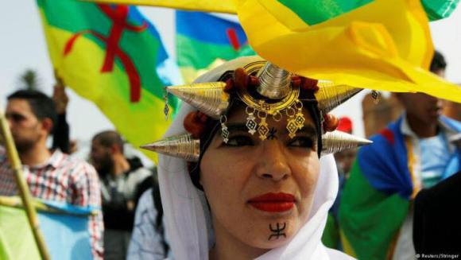
OCC Courses
BUSN 240 - Travel Seminar Marketing Across Cultures-3cr.
HUMN 251-Middle Eastern Studies- 4cr.
Conversational Arabic/Darija
Judaism in Morocco
Women, Islam and Moudawana
Morocco in African Context
Berber Identity and Minority Rights in Morocco
Cities in Morocco: The Medina
Human Rights in Morocco
The Question of Immigration in Morocco
The Political System in Morocco
UIR Lectures & Seminars

Slide 4
Field Trips

Slide 5
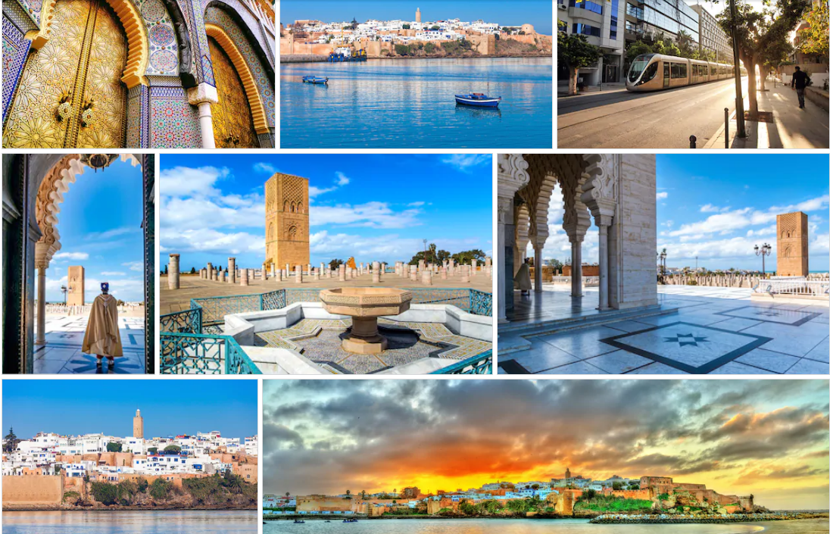
Rabatالرباط
Notes:
Chellah Site (Roman Ruins)
Hassan Tower
The Mausoleum
Kasbah of the Oudayas
the Royal Institute of Amazigh Culture
Rabat City Center
Dar Al Hadeeth AlHassania

Slide 6
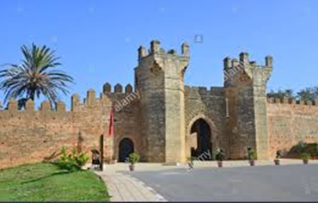
Chellah Site (Roman Ruins)
Founded in the 3rd century B.C. this Mauritanian capital was an outpost of the Roman Empire
UNESCO World Heritage Site
Houses both Roman ruins and a medieval Muslim necropolis
Occupied for ten centuries by civilizations from prehistory to the Islamic period

Slide 7
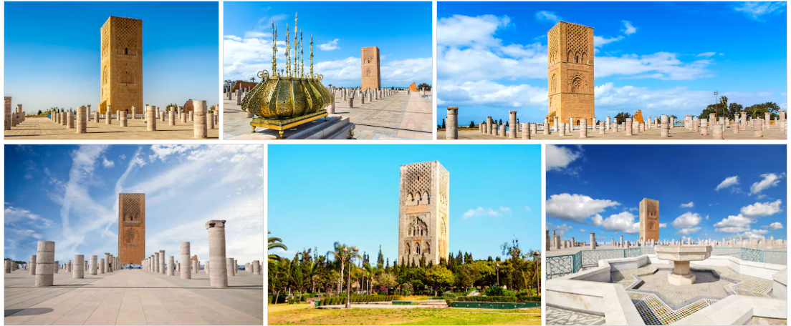
Hassan Tower
One of the monuments of Rabat
Sultan Yaqoub al Mansour gave the order to build the tower
It was supposed to be the largest minaret in the world. Yaqoub death in 1199 stopped construction
The construction consist of several walls and 200 columns that was supposed to be a mosque

Slide 8
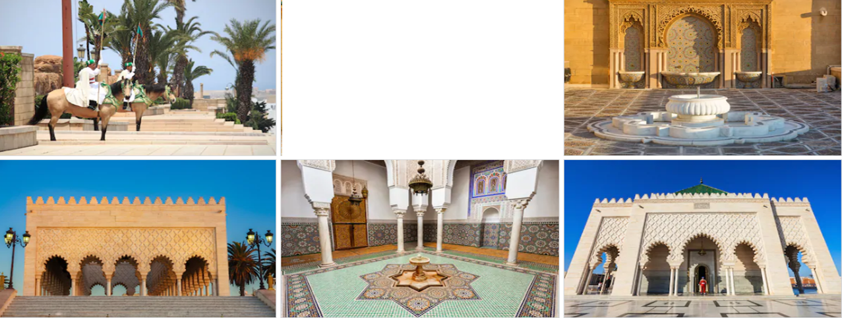
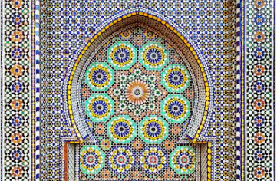
The Mausoleum
The Luxurious Tombstone owned by The King of Morocco and his sons, King Hassan II, and Prince Abdallah
The Royal Structure was envisioned by Vietnamese architect and built by local artisans

Slide 9
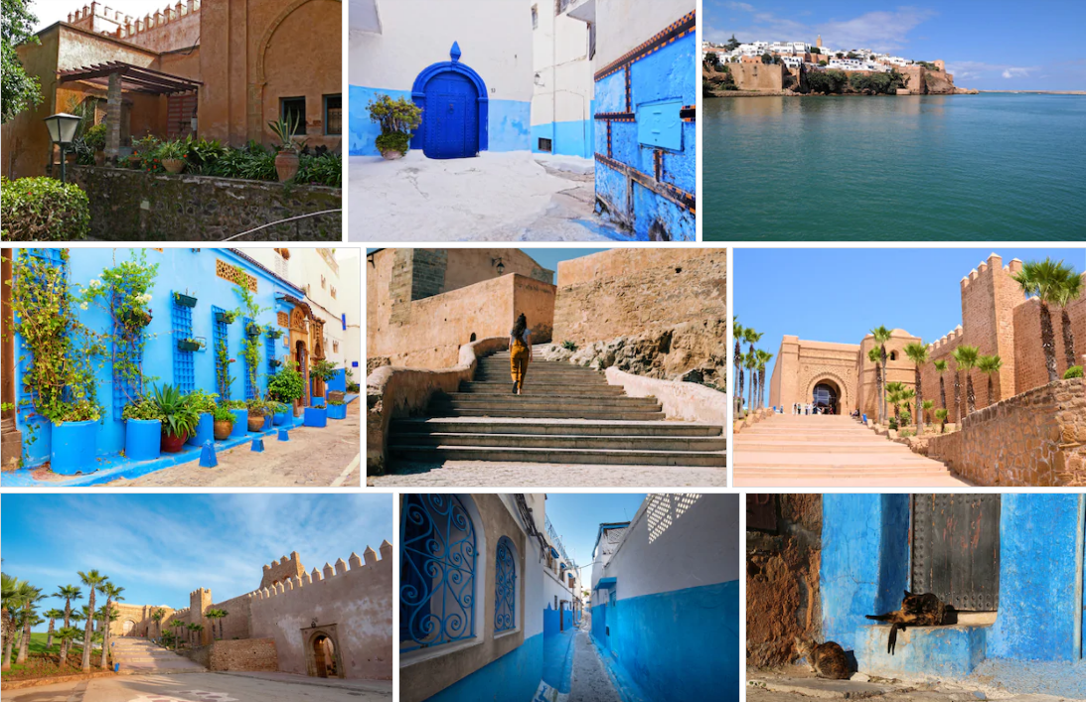
Kasbah of the Oudayas
On the mouth of the Bou Regreg river
Built in the 12th century and renovated many times since throughout the centuries, it has been home to Arab tribes, Andalusian immigrants, and some of Morocco’s most powerful sultans.

Slide 10
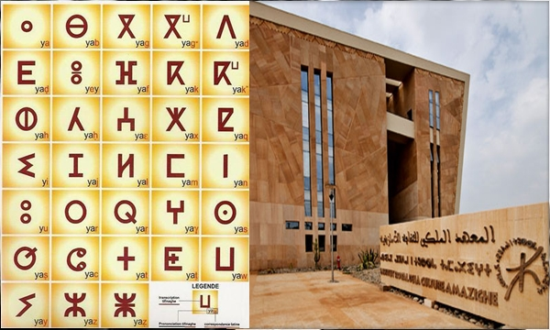
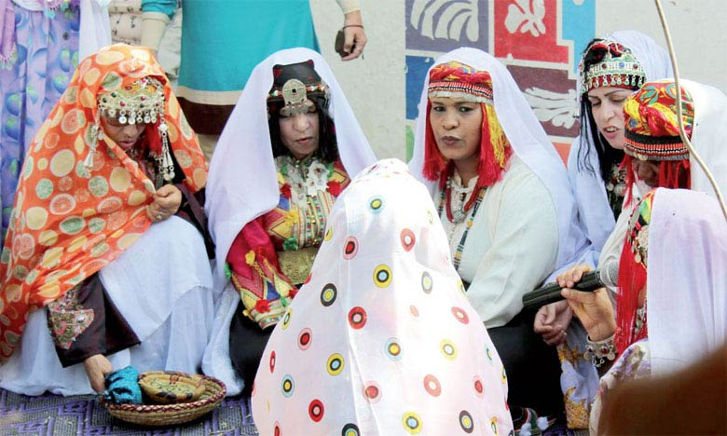
Royal Institute of Amazigh Culture
The development and the promotion of the Berber languages and culture

Slide 11
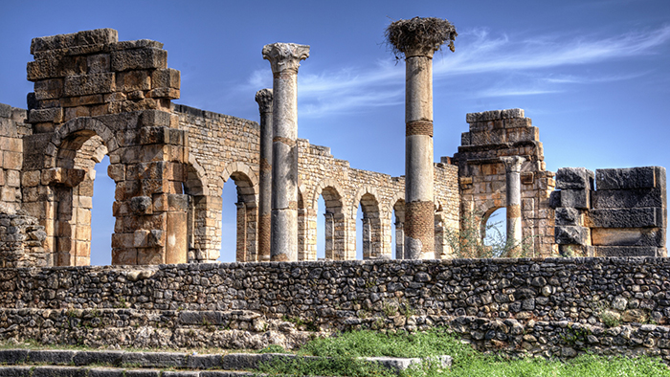
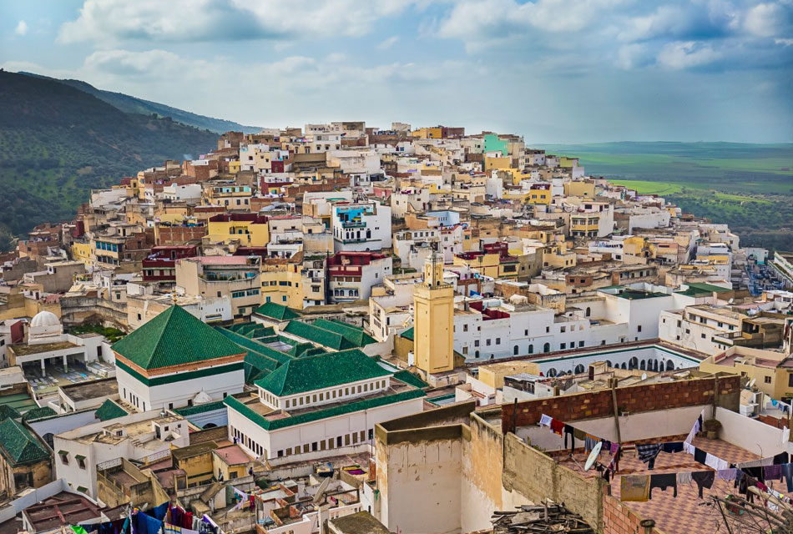
Volubilis (Roman Ruins)
Moulay Driss Zerhoun

Slide 12
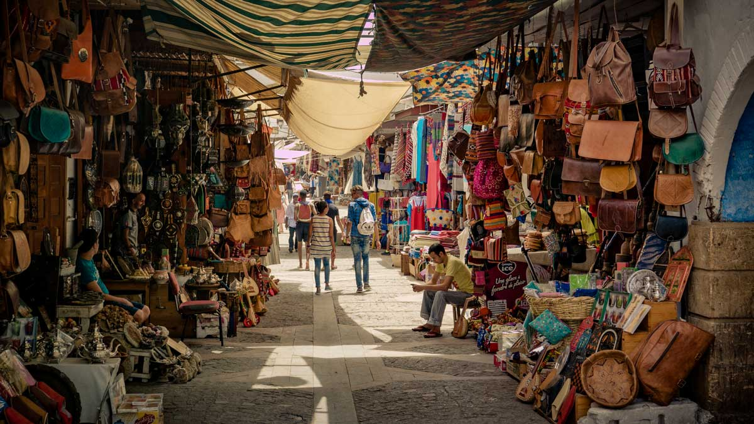
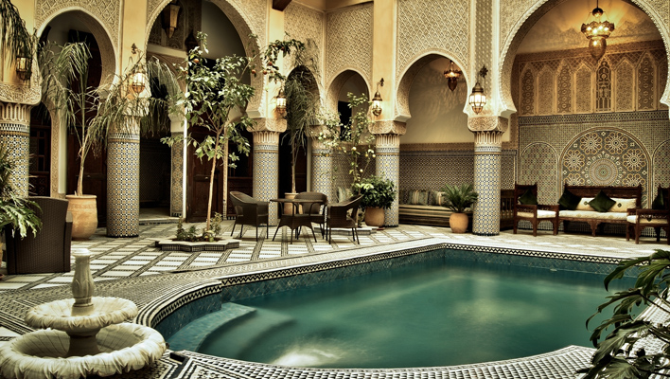
Fez
Riad

Slide 13
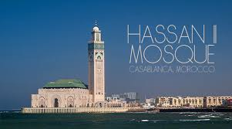
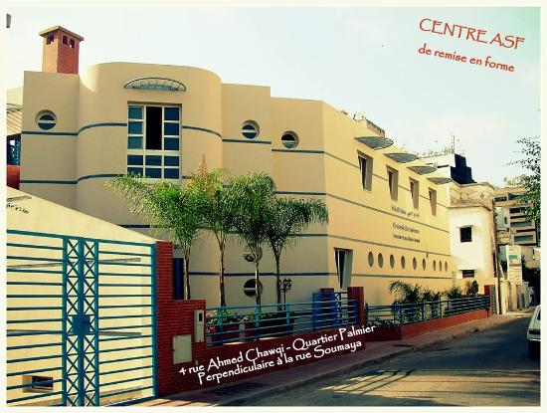
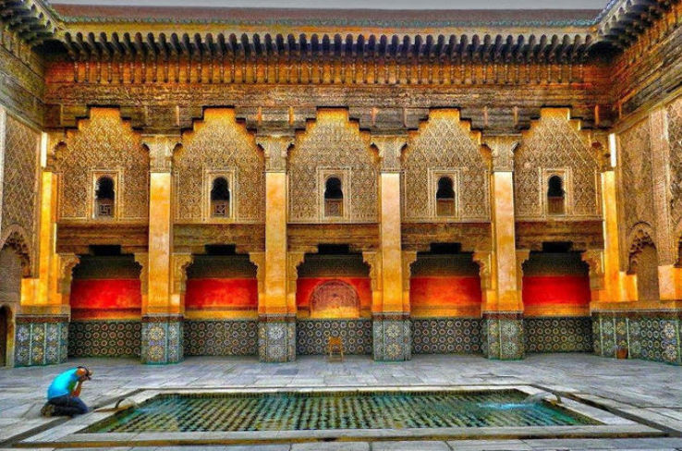
Casablanca
Hassan II Mosque
Association Solidarité Féminine (Works for Single Women)
Museum of Judaism and Jewish Culture

Slide 14
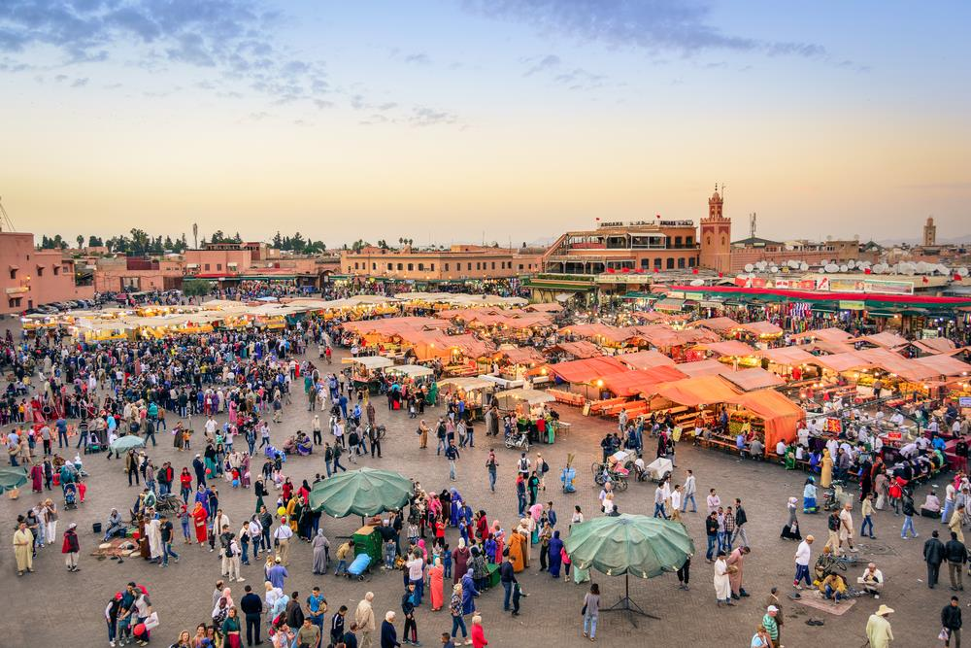
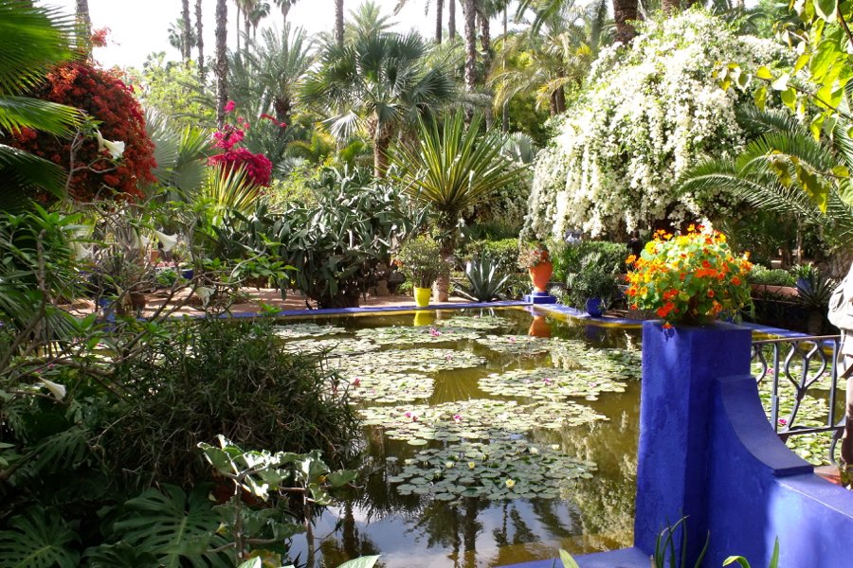
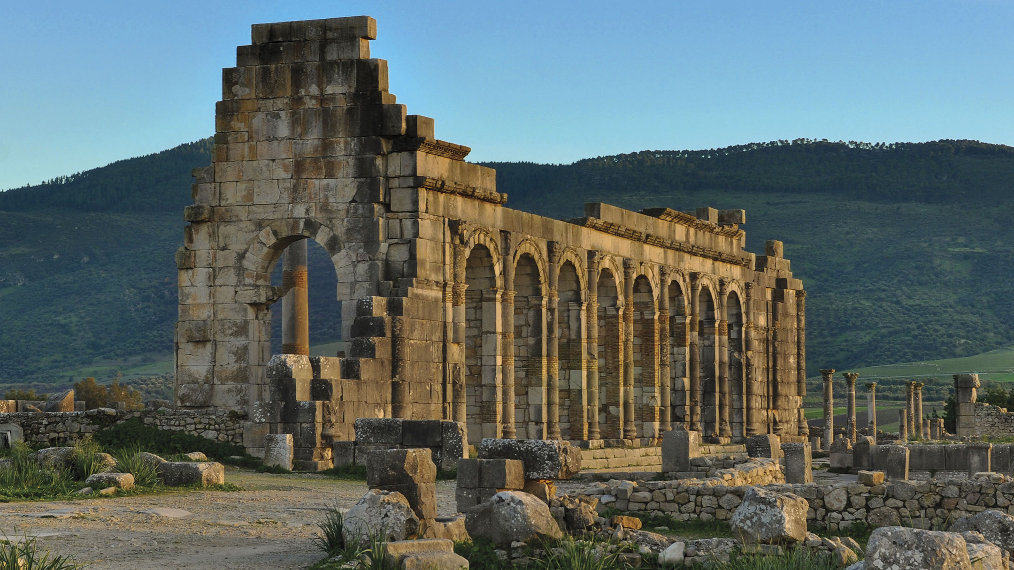
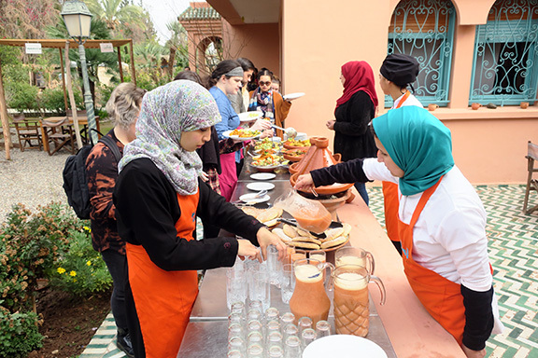
Marrakech
Jemaa El-Fnaa Square
Jardins Majorelle
Saadien Tombs
Badii Palace

Slide 15
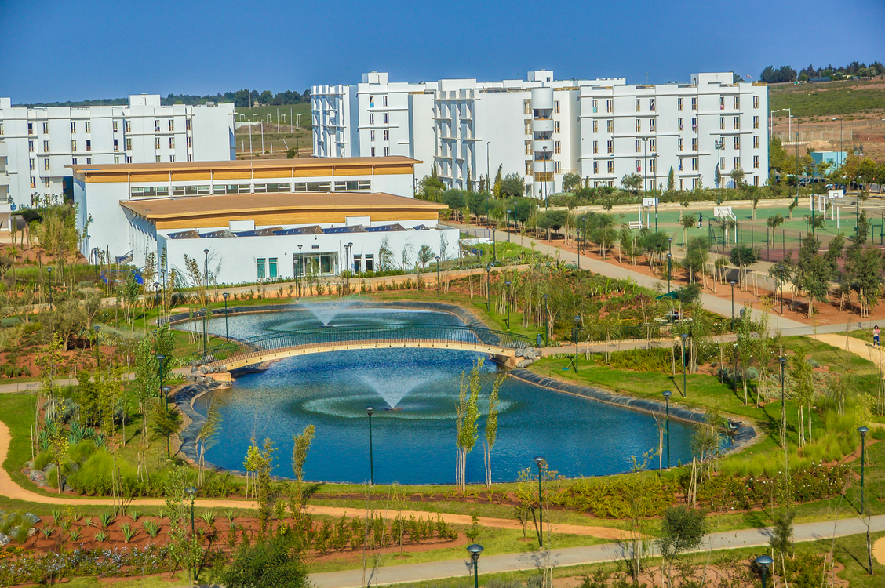
2-Week Immersion Program Languages – Cultures – History – Religions – Field Trips
Hosted by Universite Internationale de Rabat (UIR)

Slide 16
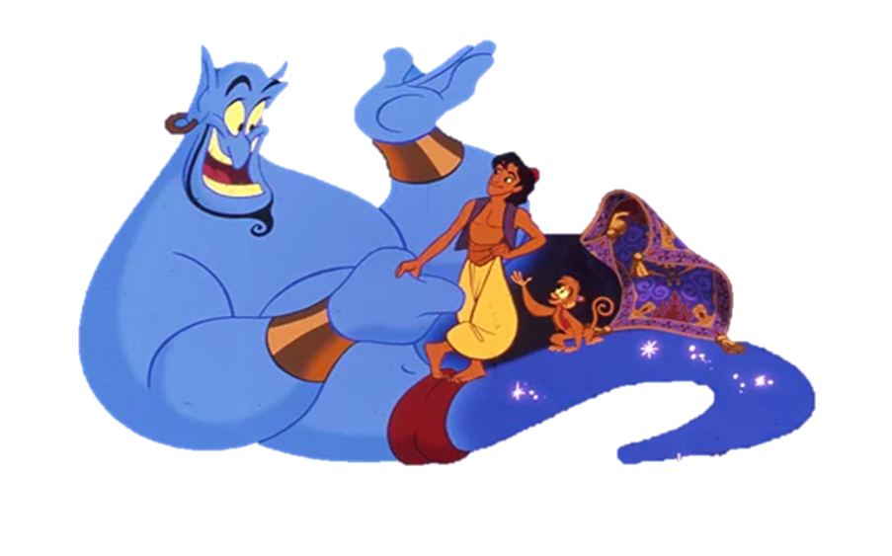
Apply for Scholarship
application is available at go.ocean.edu/Morocco

Slide 17
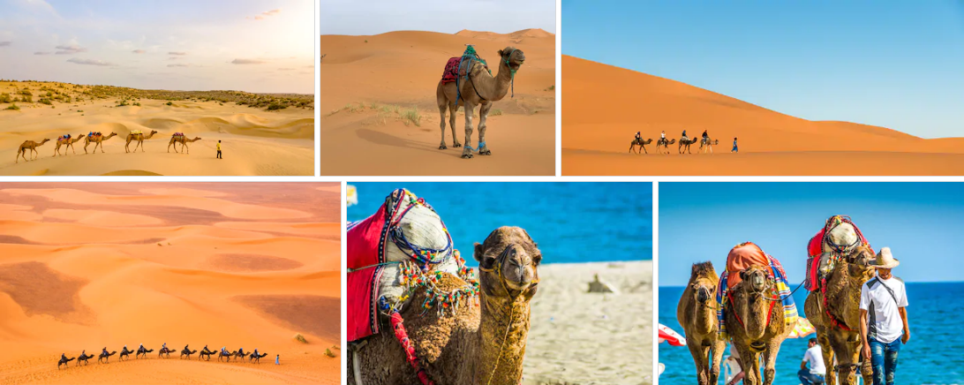
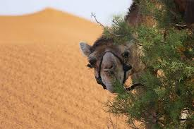
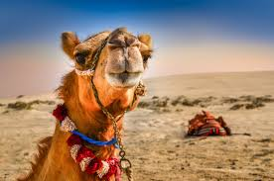
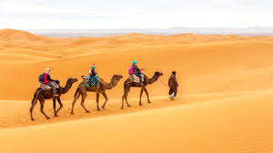
How to apply
Or Contact:
mconlon@ocean.edu
ext:2314
hwahbyeraky@ocean.edu
ext:2454
Download the application form at
go.ocean.edu/Morocco

Slide 18
For more information
Please contact:
mconlon@ocean.edu or call ext:2314
hwahbyeraky@ocean.edu or call ext:2454

Slide 19
FAQs
1. Do we meet in a group to fly together at a specified airport?
We meet at OCC and take the shuttle to the airport.
2. The cost includes both flights there and back, correct?
Yes, The cost includes the round trip
3. Do we pay extra for optional MES certificate?
You pay the tuition of the MES courses when taking them.
4. After we complete the items on the itinerary each day, is there free time?
Yes
5. Are the areas we are traveling to generally safe?
Yes, provided proper precautions are followed.
6. Are there restrictions on traveling by ourselves or other precautions put into place to ensure safety (staying in groups, curfew, etc)?
Yes, restrictions will be discussed during orientation
7. How much spend money is suggested?
Depends entirely on how much you want to spend on gifts, snacks, and other items not covered by the program.
8. Are all of our major meals covered between our host families and the scheduled lunches out?
Yes, and there will be a modest meal stipend for meals that are not included at the host family residence (most lunches during the week)
9. How about cell phones?
The basic cost of a local cell phone and a very few minutes are both included; any additional minutes will need to be purchased by the students by buying top up cards locally.
10. What should I pack?
A packing list will be in the handbook we will provide you in April.
11. Is WIFI available?
Yes , on campus and You can buy a portable stick
12 How about transportation?
All host families are within a walking distance and a cab is around $2

Slide 20
Summer 2020
Let’s go!

