Slide 1
Get Started:
Orientation Quiz
Questions? Email elearningadmin@ocean.edu
Notes:
This slide deck contains common questions regarding the Get Started module's proctored assessment entitled "Orientation Quiz."

Slide 2
Basics on Orientation Quiz
Quiz is required to unlock course content
You have unlimited attempts to complete
Quiz is not timed
Questions? Email elearningadmin@ocean.edu
Notes:
Basics on Orientation Quiz
Required to unlock course content
Unlimited Attempts
Not timed

Slide 3
Table of Contents
Walkthrough of Installation of Honorlock Chrome Extension
Walkthrough of Starting Your Quiz
Frequently Asked Questions
Questions? Email elearningadmin@ocean.edu
Notes:
Q&A Contents
Where do I find the Orientation Quiz?
Can I take the Orientation Quiz from my cellphone or tablet?
Which browser should I use?
Where do I get the Honorlock extension?
What happens when I begin my quiz?
What do I need to verify my identity?
What happens if I don't get 100%?

Slide 4
Walkthrough #1 -
Honorlock Chrome Extension
Questions? Email elearningadmin@ocean.edu
Notes:
Q&A Contents
Where do I find the Orientation Quiz?
Can I take the Orientation Quiz from my cellphone or tablet?
Which browser should I use?
Where do I get the Honorlock extension?
What happens when I begin my quiz?
What do I need to verify my identity?
What happens if I don't get 100%?

Slide 5
Step 1 - Chrome Extension:
Navigate to the Orientation Quiz, Select "I agree" to the Terms of Service, and then use the "Get Started" button to proceed. This will bring you to the extension's installation page.
Questions? Email elearningadmin@ocean.edu
Notes:
Where do I get the Honorlock extension?
Navigate to the Orientation Quiz, Select "I agree" to the Terms of Service, and then use the "Get Started" button to proceed. This will bring you to the extension's installation page.

Slide 6
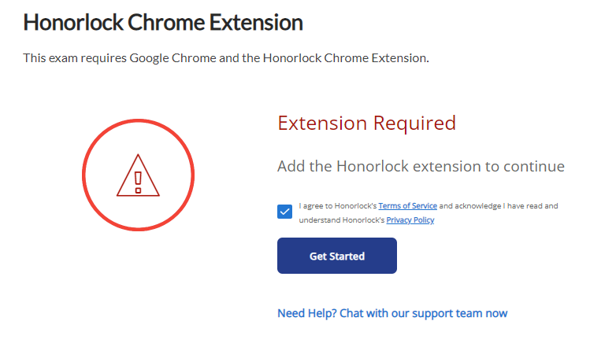
Step 1 - Chrome Extension:
Below is a sample of what you may see.
Questions? Email elearningadmin@ocean.edu
Notes:
On this slide is a sample of what you will see.

Slide 7
Step 2 - Chrome Extension:
You will be prompted to add the extension to their Chrome browser.
Questions? Email elearningadmin@ocean.edu
Notes:
You will be prompted to add the extension to their Chrome browser.

Slide 8
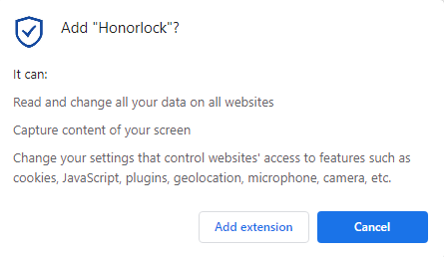
Step 3 - Chrome Extension:
Select "Add extension" to continue.
Questions? Email elearningadmin@ocean.edu
Notes:
Select "Add extension" to continue.

Slide 9
Step 4 - Chrome Extension:
Once the Honorlock Chrome Extension installation is complete, you will be able to begin the quiz.
Questions? Email elearningadmin@ocean.edu

Slide 10
Walkthrough #2 -
Starting Your Quiz
Questions? Email elearningadmin@ocean.edu
Notes:
Q&A Contents
Where do I find the Orientation Quiz?
Can I take the Orientation Quiz from my cellphone or tablet?
Which browser should I use?
Where do I get the Honorlock extension?
What happens when I begin my quiz?
What do I need to verify my identity?
What happens if I don't get 100%?

Slide 11
Step 1 - Starting Your Quiz:
You will be prompted to authorize Honorlock, Review Exam Guidelines, and then Run a System Check before you can launch proctoring.
Questions? Email elearningadmin@ocean.edu
Notes:
What happens if I don't get a 100%?

Slide 12
Step 1 - Authorize and Continue to Exam Guidelines:
Questions? Email elearningadmin@ocean.edu
Notes:
What happens if I don't get a 100%?

Slide 13
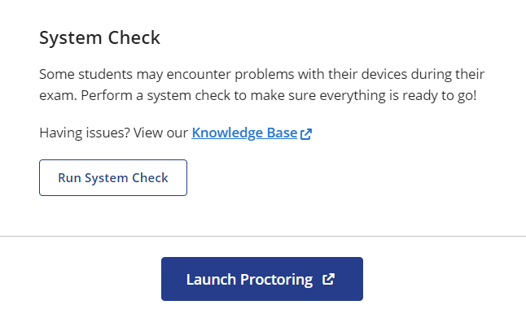
Step 2 - Run System Check & Launch Proctoring
Questions? Email elearningadmin@ocean.edu
Notes:
What happens if I don't get a 100%?

Slide 14
FAQ
Where do I find the Orientation Quiz?
Can I take the Orientation Quiz from my cellphone or tablet?
Which browser should I use?
What do I need to verify my identity?
What will happen if the name on my ID does not match my name on file?
What happens if I don't get 100%?
Will I be dropped for not completing the quiz?
Will someone reach out to me if I haven't completed the quiz?
What is the deadline for completing the quiz?
Honorlock is asking me for a password. Where do I find it?
Questions? Email elearningadmin@ocean.edu
Notes:
Q&A Contents
Where do I find the Orientation Quiz?
Can I take the Orientation Quiz from my cellphone or tablet?
Which browser should I use?
Where do I get the Honorlock extension?
What happens when I begin my quiz?
What do I need to verify my identity?
What happens if I don't get 100%?

Slide 15
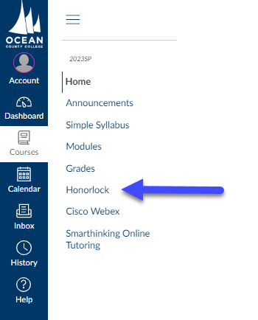
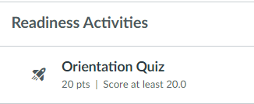
Q1:
Where do I find the Orientation Quiz?
A1:
Find it in your left navigation menu by clicking "Honorlock" OR navigate to the Get Started module. Under "Readiness Activities" you will find the quiz.
Questions? Email elearningadmin@ocean.edu
Notes:
Where do I find the Orientation Quiz?
Navigate to the Get Started module. Under "Readiness Activities" you will find the quiz.

Slide 16
Q2:
Can I take the Orientation Quiz from my cell phone or tablet?
A2:
A laptop or desktop device is required. Chromebooks may not be compatible with Honorlock. For more information, visit the System Requirements page.
Questions? Email elearningadmin@ocean.edu
Notes:
Can I take the Orientation Quiz from my cell phone or tablet?
A laptop or desktop device is required. Chromebooks may not be compatible with Honorlock. For more information, visit the System Requirements page.

Slide 17
Q3:
Which browser should I use?
A3:
Google's Chrome browser is required to take an assessment proctored by Honorlock.
Questions? Email elearningadmin@ocean.edu
Notes:
Which browser should I use?
Google's Chrome browser is required to take an assessment proctored by Honorlock.

Slide 18
Q4:
What do I need to verify my identity?
A4:
Honorlock agents verify the photo and name on your ID to ensure you are the correct test taker. You can use any government-issued ID (i.e. driver's license, passport) or a student ID that has your photo.
Questions? Email elearningadmin@ocean.edu

Slide 19
Q5:
What will happen if the name on my ID does not match my name on file?
A5:
When names don’t match, verification will fail. After so many “failed” attempts, an Honorlock support agent will initiate a live chat and work with you to manually verify the ID.
Questions? Email elearningadmin@ocean.edu

Slide 20
Q6:
What happens if I don't get a 100%?
A6:
You have unlimited attempts to get the required 100% score. Until you achieve this score, the remaining course modules will remain locked.
Questions? Email elearningadmin@ocean.edu
Notes:
What happens if I don't get a 100%?

Slide 21
Q7:
Will I be dropped for not completing the quiz?
A7:
No. You will not be dropped for not completing the quiz. You will be marked as non-attending on the final class roster.
Questions? Email elearningadmin@ocean.edu
Notes:
What happens if I don't get a 100%?

Slide 22
Q8:
Will someone reach out to me if I haven't completed the quiz?
A8:
Faculty have been instructed to encourage students to complete the orientation quiz. This communication would use the Canvas Inbox system.
Questions? Email elearningadmin@ocean.edu
Notes:
What happens if I don't get a 100%?

Slide 23
Q9:
What is the deadline for completing the quiz?
A9:
You will have up until the census date to complete the orientation quiz.
Questions? Email elearningadmin@ocean.edu
Notes:
What happens if I don't get a 100%?

Slide 24
Q10:
Honorlock is asking me for a password. Where do I find it?
A10:
This indicates you are either not using Google Chrome (see Q3) and/or you have not installed the extension (see Walkthrough #1).
Questions? Email elearningadmin@ocean.edu
Notes:
What happens if I don't get a 100%?

Slide 25
Who do I contact for help?
Support tickets regarding Honorlock will only be addressed by the e-Learning Department if escalated by the vendor. If you need assistance pertaining to Honorlock, please contact Honorlock Support directly. Support is available 24/7/365.
Phone: 1.844.243.2500
Email: support@honorlock.com
Use the LiveChat feature by visiting the Honorlock Support page
Please note that as of September 2022, e-Learning students will no longer be required to conduct a room scan.
Questions? Email elearningadmin@ocean.edu

