Slide 1
World literature: 1600 to Present introduction
Dr. Bordelon

Slide 2
Course basics
Syllabus
Introduction
Website

Slide 3
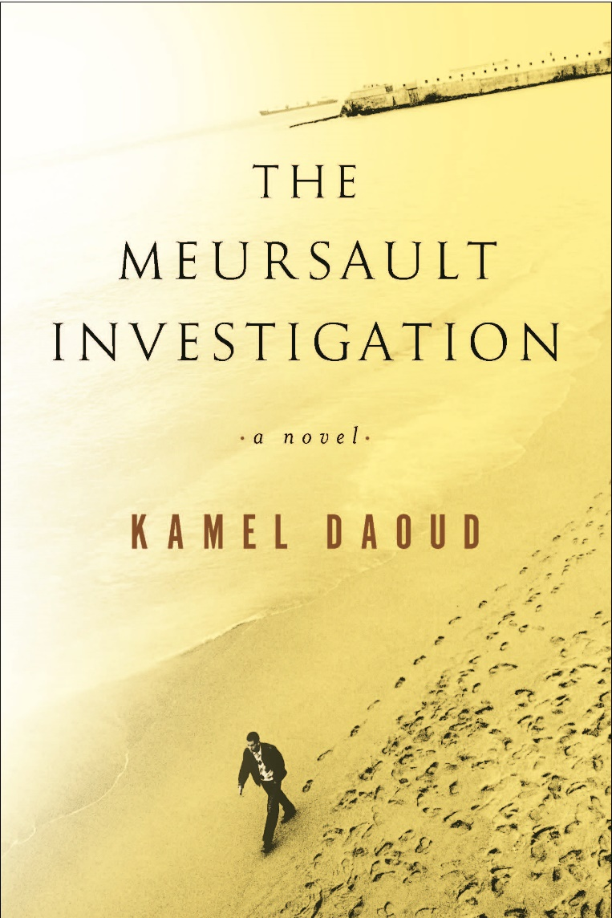
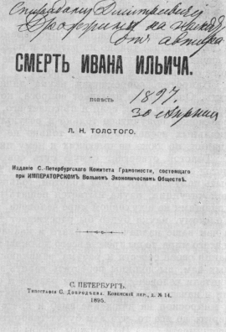
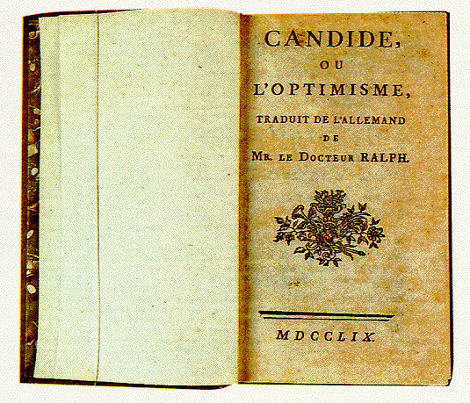
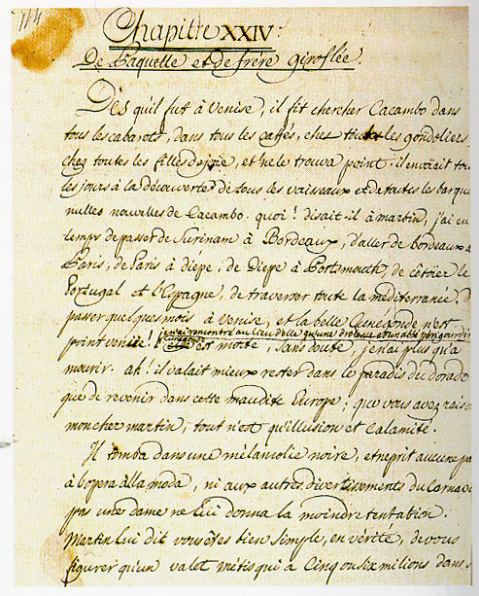
What is World Lit
Simple: The study of literature from 1600 to today from other countries
Notes:
http://www.allaboutarchaeology.org/images/epic-of-gilgamesh.jpg
http://www.uh.edu/news-events/stories/2012/august/editveritas.jpg
http://www.italnet.nd.edu/Dante/images/tp1472/1472-inf1.jpeg
http://shea.mit.edu/ramparts/commentaryguides/what_is_a_folio/rulelines/hamletq2.jpg

Slide 4
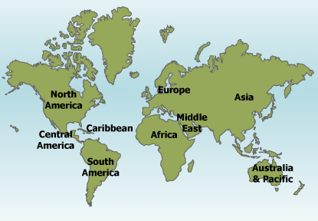
Where are we?
Notes:
http://www.reed.edu/humanities/hum110/assets/images/maps/fall/Gilgamesh.jpg
http://www-tc.pbs.org/empires/thegreeks/img/background/illustrations/46.jpg
1st map: Rest of the world at the time of Classic Greece

Slide 5
What will we do?
Learn
“To read well, that is, to read true books in a true spirit, is a noble exercise, and one that will task the reader more than any exercise which the customs of the day esteem. It requires a training such as the athletes underwent, the steady intention almost of the whole life to this object. Books must be read as deliberately and reservedly as they were written” (Thoreau)
Understand
Read and annotate and think
Discuss – as a class and in groups
Communicate ideas in writing.
Notes:
Learn about different cultures, ideas, and people
Understand the way literature shapes culture and creates meaning
Using your annotations and thoughts, discuss the works – as a class and in groups – to generate meanings.
Ultimately, you can look at this as an advanced reading class – and reading well is not easy. As the American writer Henry David Thoreau noted in Walden

Slide 6
“What’s in it for me?”
Theory of Mind (ToM) "The capacity to identify and understand others’ subjective states [ . . . .which] allows successful navigation of complex social relationships and helps to support the empathic responses that maintain them" (Comer Kidd and Castano).
“the worlds of literary fiction are replete with complicated individuals whose inner lives are rarely easily discerned but warrant exploration” (Comer Kidd and Castano).
Let’s start with you
Travis Proulx and Steven J. Heine found that subjects who read works which deeply challenge their preconceived views of the world had improved scores on pattern recognition tests and thus “demonstrated enhanced learning.”
Sociological critics “consider works of art, I think, as strategies for selecting enemies, and allies, for socializing losses, for warding off evil eye, for purification, propitiation, and desanctification, consolation and vengeance, admonition and exhortation, implicit commands or instructions of one sort or another. Art forms like ‘tragedy’ or ‘comedy’ or ‘satire’ would be treated as equipments for living, that size up situations in various ways and in keeping with correspondingly various attitudes” (Burke 81)
Notes:
Kenneth Burke

Slide 7
How to do well
Plan
Time
Persistence and Tenacity
Notes:
Plan
Time
Persistence

Slide 8
Dweck: Growth Mindset
Fixed Mindset
“In a fixed mindset, people believe their basic qualities, like their intelligence or talent, are simply fixed traits. They spend their time documenting their intelligence or talent instead of developing them. They also believe that talent alone creates success—without effort.” Dweck’s research suggests that students who have adopted a fixed mindset—the belief that they are either “smart” or “dumb” and there is no way to change this, for example—may learn less than they could or learn at a slower rate, while also shying away from challenges (since poor performance might either confirm they can’t learn, if they believe they are “dumb,” or indicate that they are less intelligent than they think, if they believe they are “smart”). Dweck’s findings also suggest that when students with fixed mindsets fail at something, as they inevitably will, they tend to tell themselves they can’t or won’t be able to do it (“I just can’t learn Algebra”), or they make excuses to rationalize the failure (“I would have passed the test if I had had more time to study”).
Growth Mindest
“In a growth mindset, people believe that their most basic abilities can be developed through dedication and hard work—brains and talent are just the starting point. This view creates a love of learning and a resilience that is essential for great accomplishment,” writes Dweck. Students who embrace growth mindsets—the belief that they can learn more or become smarter if they work hard and persevere—may learn more, learn it more quickly, and view challenges and failures as opportunities to improve their learning and skills
Notes:
Now let’s start that growth with an essential topic for our course: Myth

Slide 9
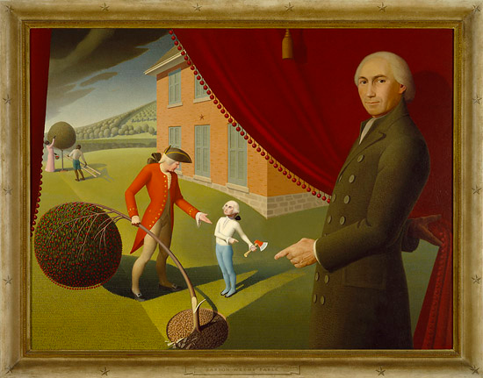
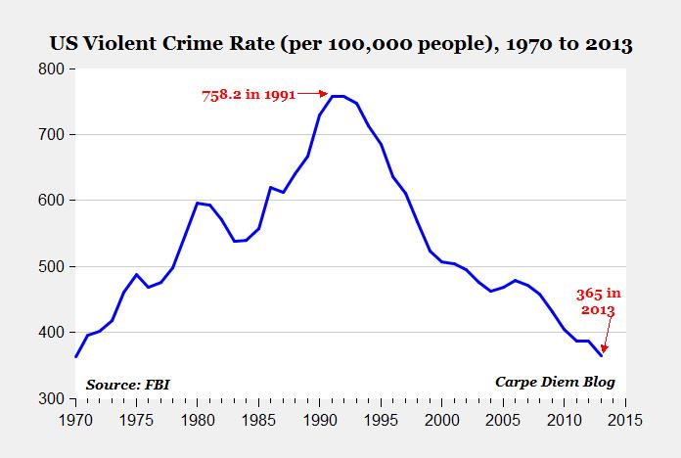
myths
What’s been the crime rate over the last 15 years?
“A kind of story or rudimentary narrative sequence, normally traditional and anonymous, through which a given culture ratifies its social customs or accounts for the origins of human and natural phenomena, usually in supernatural or boldly imaginative terms” (Baldick). Oxford Dictionary of Literary Terms
“A people unaware of its myths is likely to continue living by them, though the world around that people may change and demand changes in their psychology, their world view, their ethics, and their institutions” (Slotkin 5)
“an idea or story that is believed by many people but that is not true” Merriam Webster
Mythos in Greek means “story” or “rumor”
Notes:
Baldick, Chris. "myth." The Oxford Dictionary of Literary Terms. : Oxford University Press, 2015. Oxford Reference. 2015. Date Accessed 5 Aug. 2016 &lt;http://www.oxfordreference.com/view/10.1093/acref/9780198715443.001.0001/acref-9780198715443-e-754&gt;.Format
National myths
Social myths
http://4.bp.blogspot.com/-fXoyWVFCHxg/USF7X_mqgCI/AAAAAAAAFtw/sdvVOQOPTIE/s1600/parson+weems+cherry+tree.jpg
http://www.aei.org/wp-content/uploads/2014/07/crime.jpg
Why we need to study myth? “A people unaware of its myths is likely to continue living by them, though the world around that people may change and demand changes in their psychology, their world view, their ethics, and their institutions” (Slotkin 5)
Get students to go to handout.

Slide 10
Reading world literature
How does it represent a different culture/worldview than 21st century Jersey shore?
How is it similar?

Slide 11
Time to get started
Review work for next class in syllabus (come to class prepared for a quiz and to discuss the assigned reading).
Get started reading and annotating
Review notes on course site
Try setting aside particular times each week to complete course work.
Looking forward to your thinking on the work.

