Slide 1
Biol-119 Lab
Practical Exam 1
Sec-01
Fall 2021

Slide 2
Lab Saftey
Anatomy and Physiology II
True or False
1- Only solid food is allowed in lab.
2- Any accident that happens in the lab has to be reported to the professor.
3- The lab will be cleaned by the lab assistant.

Slide 3
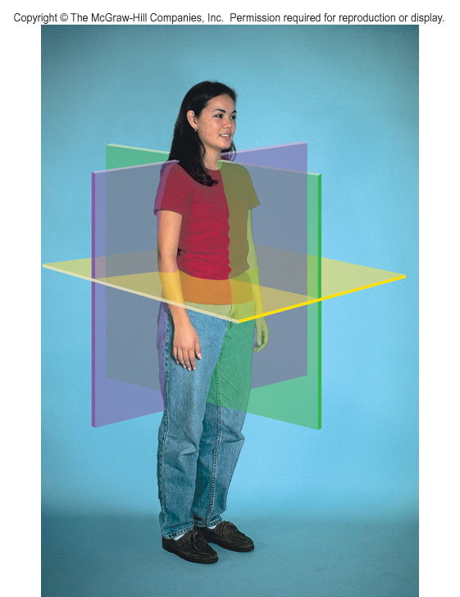
#4
Name
the planes.
#5

Slide 4
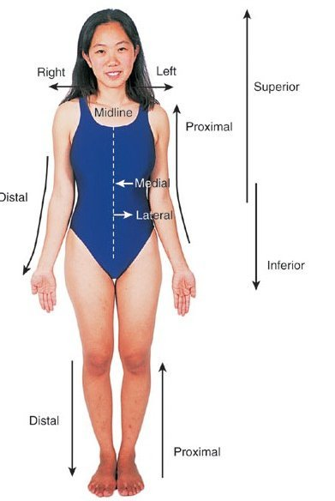
Match the Terms of Position
with the Number
6
8
10
Distal
Left
Superior
Right
Inferior
Proximal
9
7
11
7
9

Slide 5
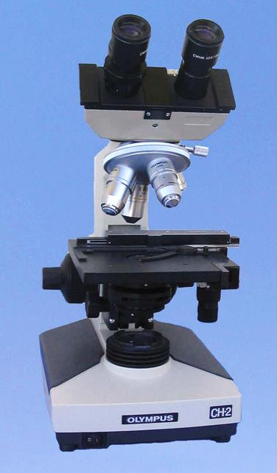
#12
#13
#14
#15
#16

Slide 6
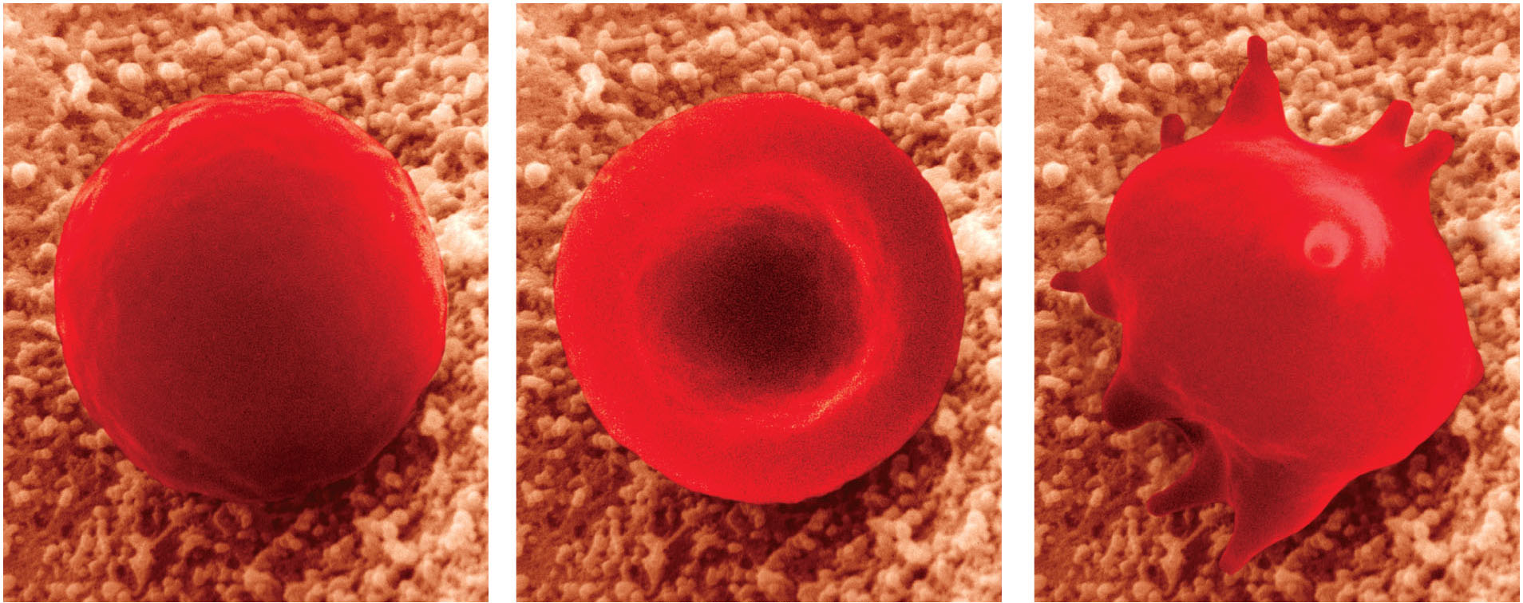
17- Which of these blood cells is in a hypertonic solution?
18- Which is in a Isotonic solution?
19- Which is in a hypotonic solution?
A
B
C

Slide 7
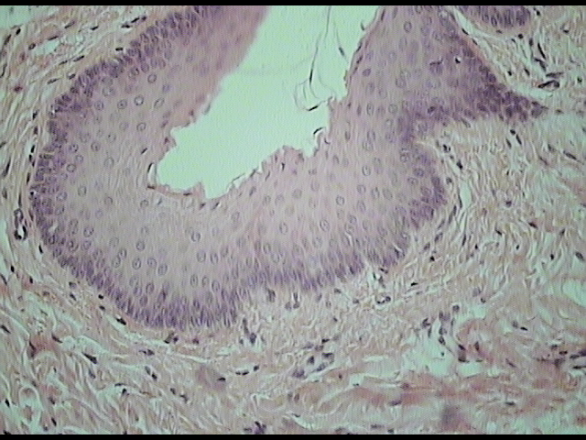
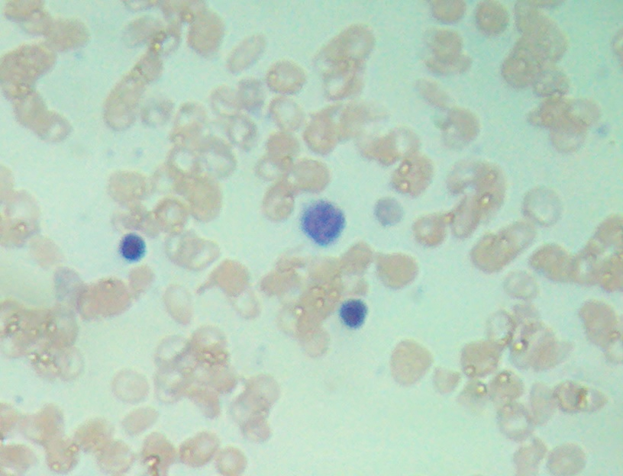
Match the tissues on the right
With it’s name on the left
Stratified Squamous
20
Transitional
Blood
21
Kidney

Slide 8
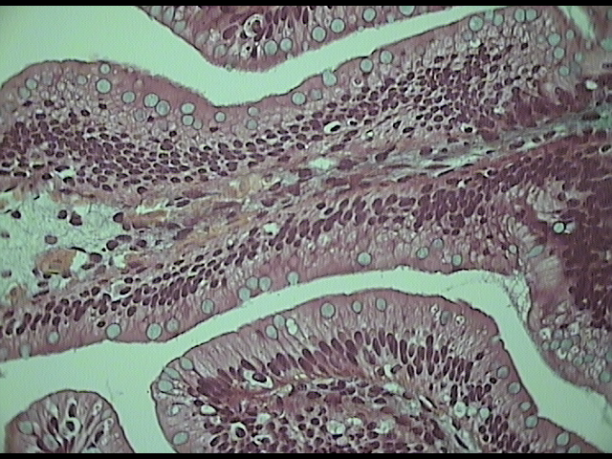
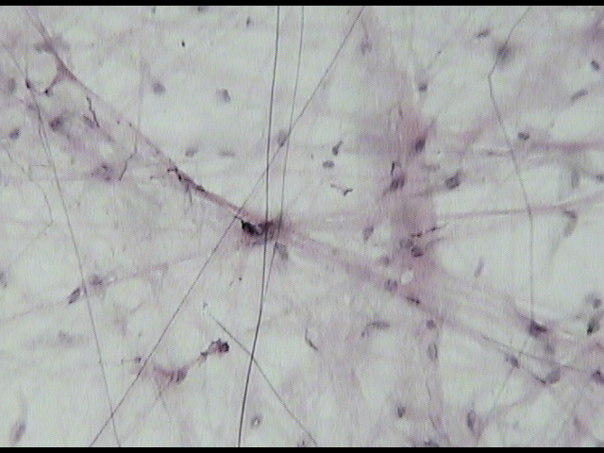
Match the tissues on the right
With it’s name on the left
Simple Columnar
22
Simple cuboidal
Transitional
23
Areolar

Slide 9
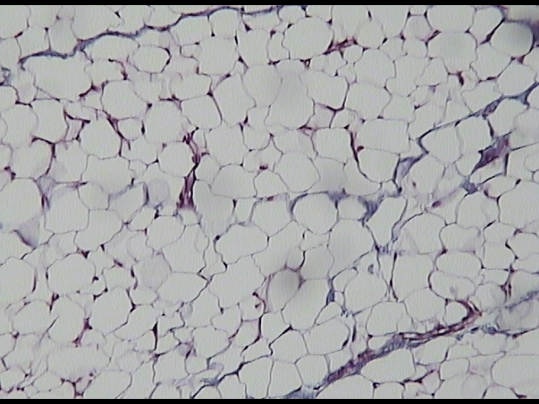
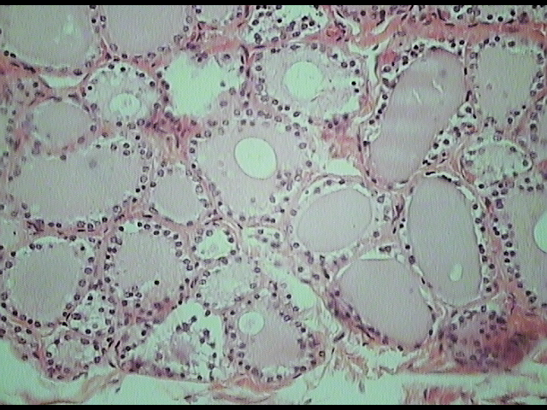
Match the tissues on the right
With it’s name on the left
Simple Squamous
24
Simple Cuboidal
Bone
25
Adipose

Slide 10
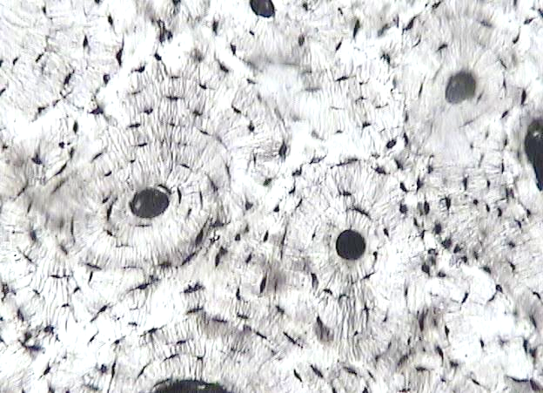
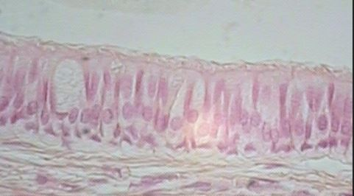
Match the tissues on the right
With it’s name on the left
Pseudostratified
26
Simple Cuboidal
Bone
27
Adipose

Slide 11
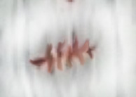
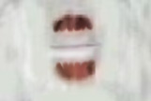

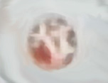
Match the stage of Mitosis
to the photo on the right
28
Prophase
29
Metaphase
Anaphase
30
Telophase
31

Slide 12
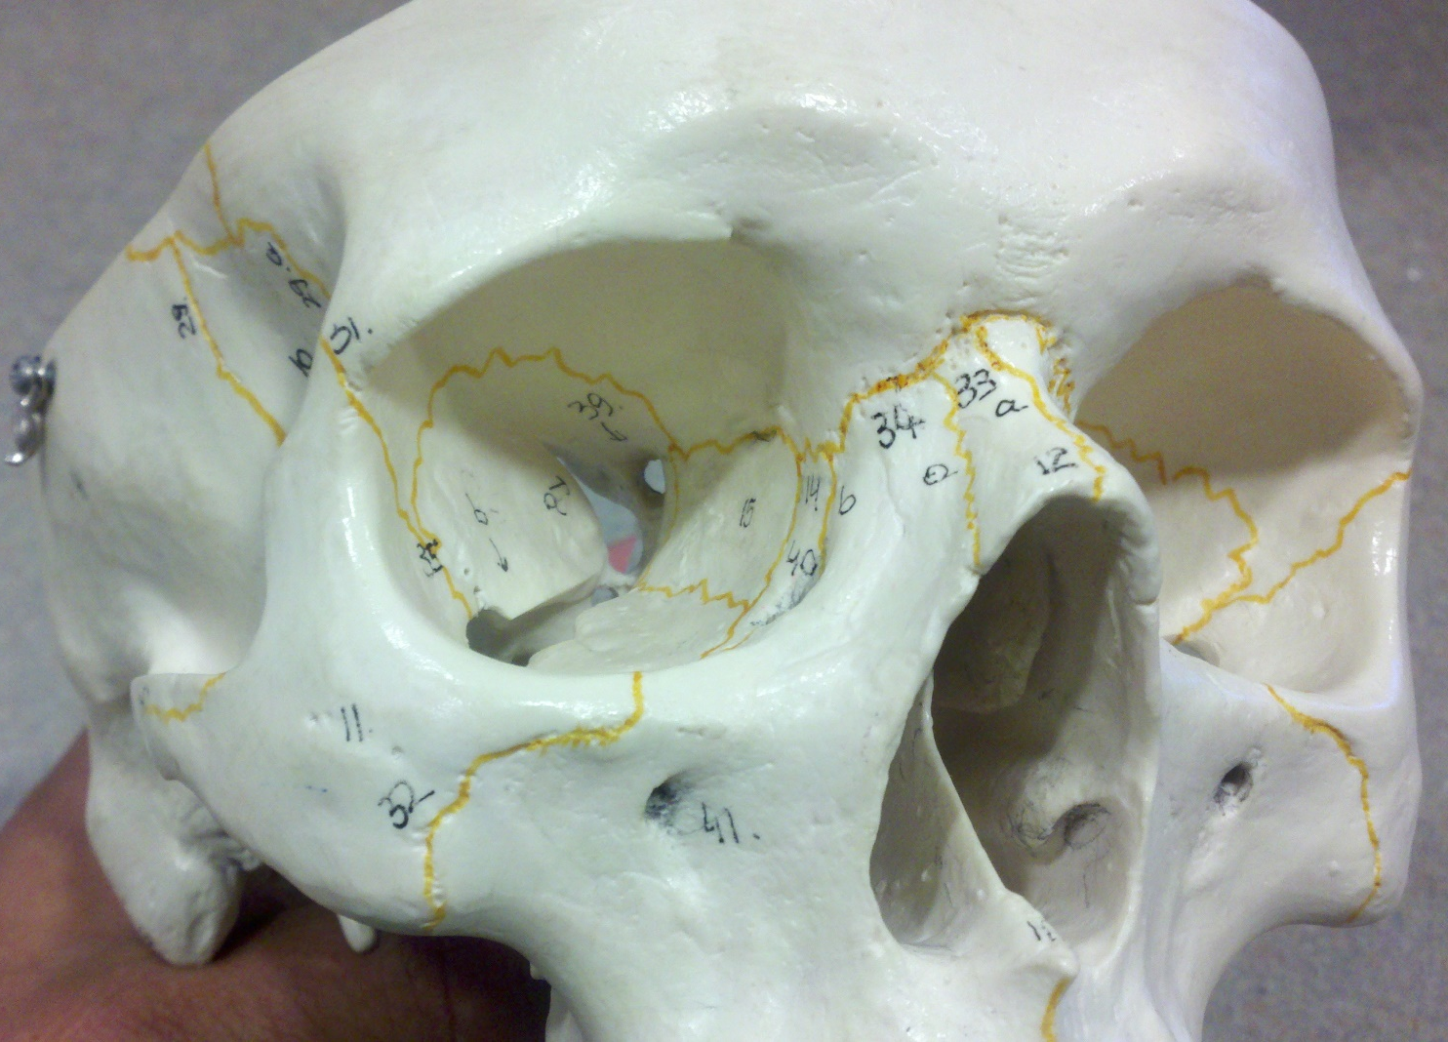
Name these Bone
#32
#33
#34
#35

Slide 13
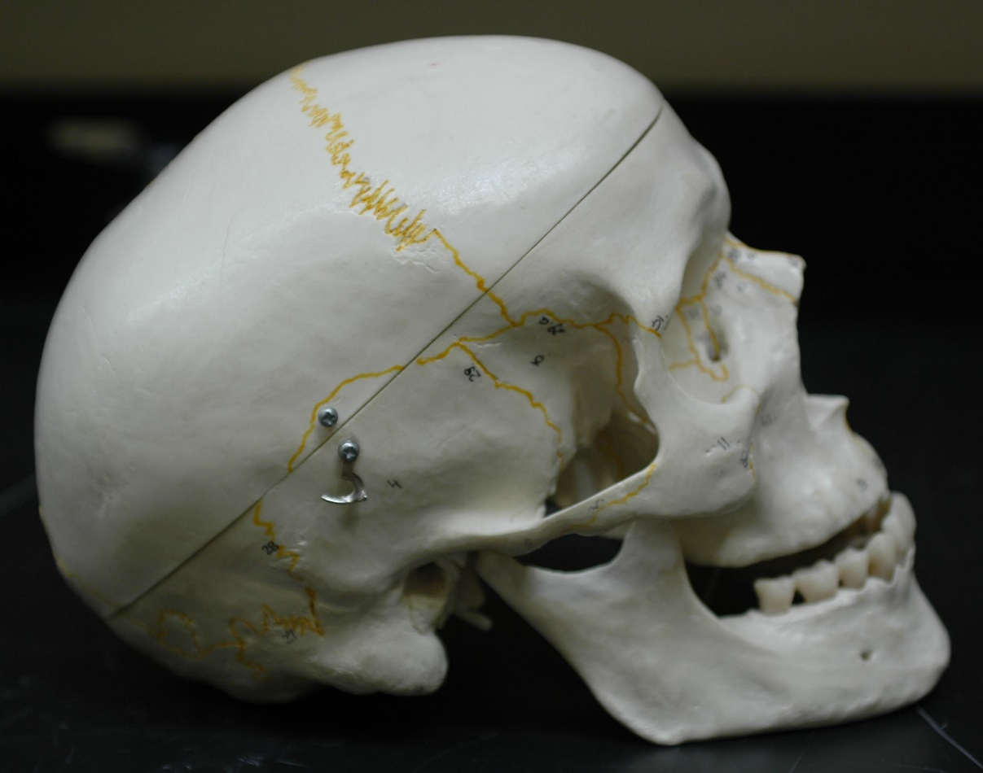
Name These Features
#36
#37
#38
#39
#40
Lateral View of the Skull

Slide 14
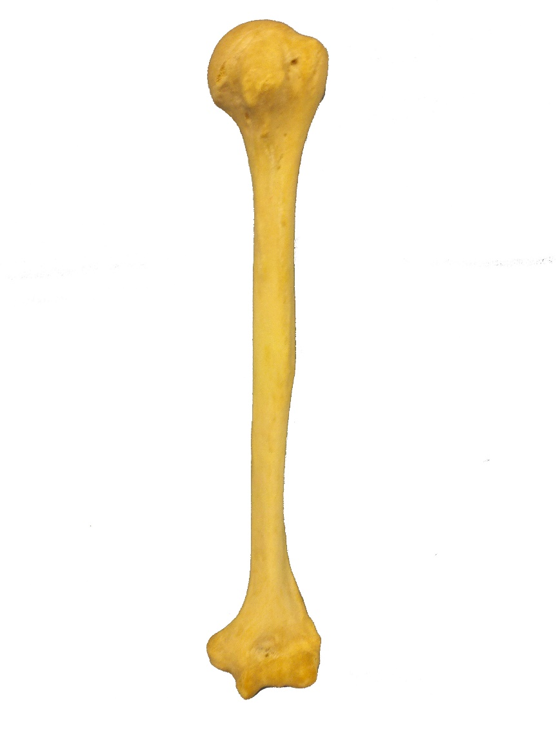
Name These Features
#41
#42
#43
#44
Anterior View of Left Homarus

Slide 15
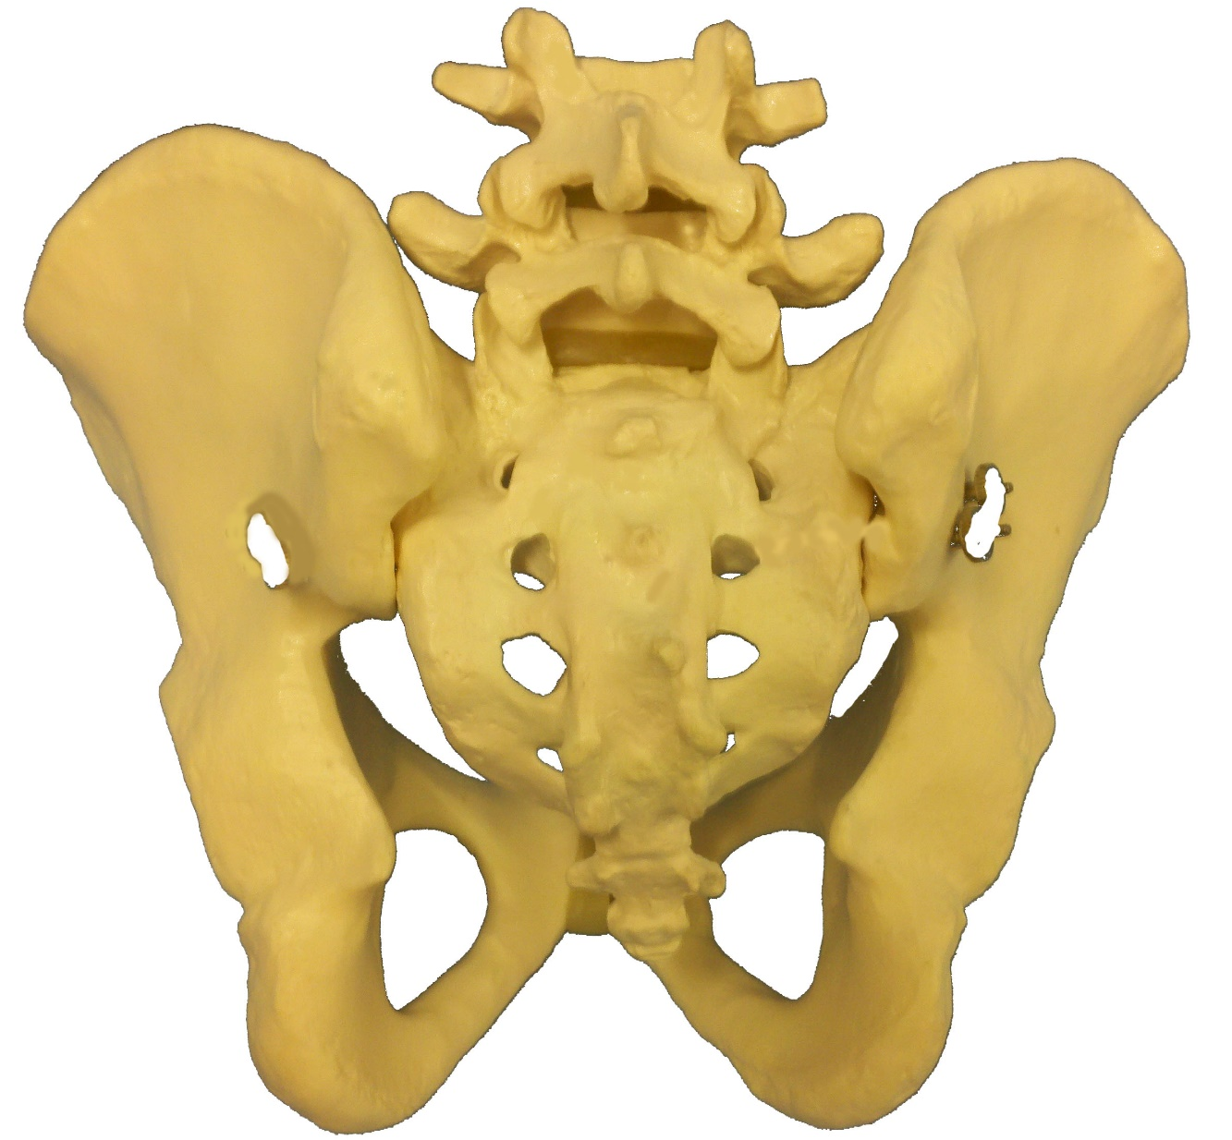
Name These Bones
#45
#46
#47
Posterior View of Pelvis

Slide 16
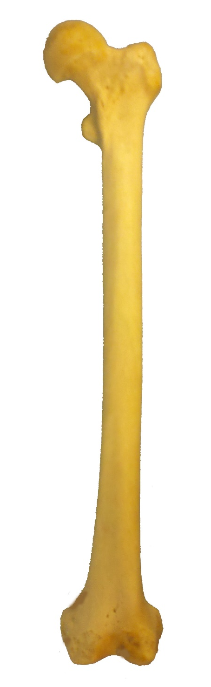
Name These Features
#48
#49
Anterior View of Left Femur
#50

Slide 17
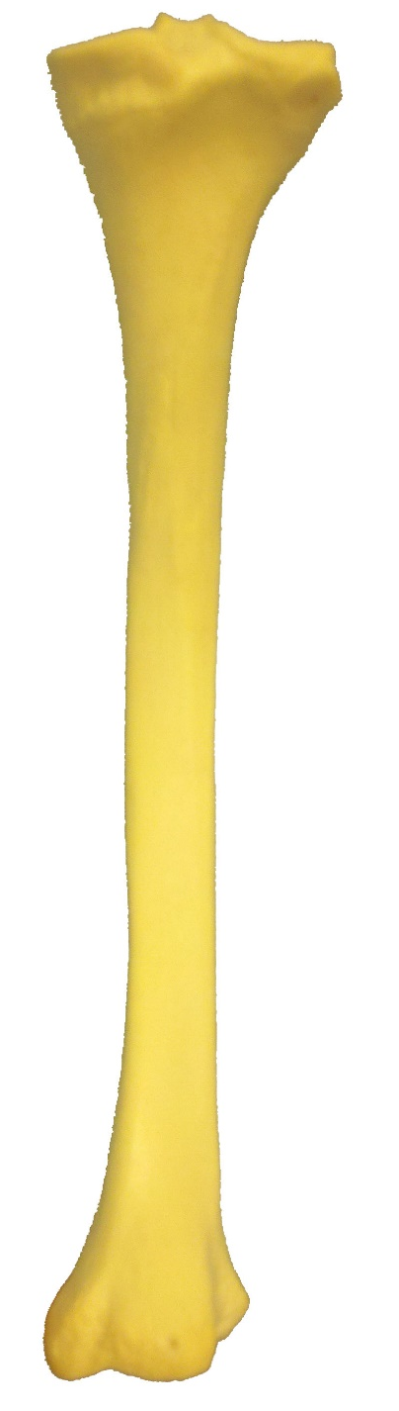
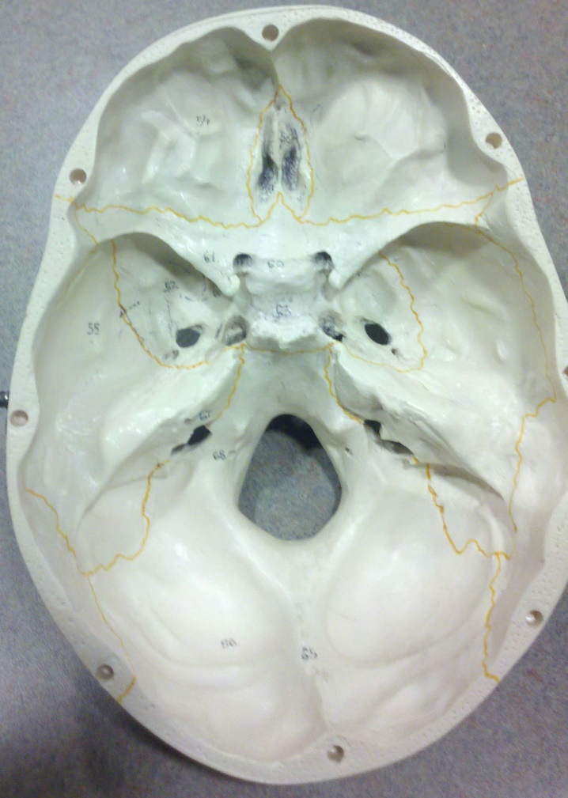
Extra Credit
#51
#52
#53
#54
#55

