Slide 1
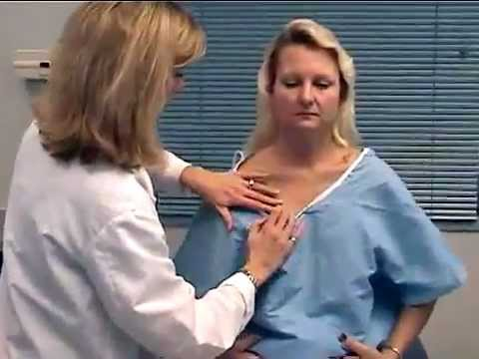
PHYSICAL ASSESSMENT
WORKSHOP

Slide 2
PHYSICAL ASSESSMENT
Organized & Systematic
  Head to Toe
  General to specific
  System by system
  Objective/Subjective
  Can be comprehensive, system specific, focused
Notes:
Objective : Physical assessment findings, vital signs, lab data, diagnostic tests
Subjective: What the patient tells you

Slide 3
FOCUSED ASSESSMENTS
RESP SYSTEM
  Effort: dyspnea, pursed lip breathing, labored
  Color
  RR
  Rhythm
  Breath sounds
  O2 Saturation
  Secretions/cough
  Respiratory support: oxygen, ventilator,
CARDIO-VASC SYSTEM
  Skin temp
  Turgor
  Capillary refill
  Apical pulse
  Heart sounds: normal S1, S2, clicks, murmurs, gallops
  Peripheral pulses
  edema

Slide 4
FOCUSED ASSESSMENTS
GI SYSTEM
  Mucosa
  Abdomen: soft, distended, ascites, incisions, girth
  Bowel sounds
  Bowel movements & characteristics
  Continence
  Nausea/vomiting
  Nutritional intake
  Tubes (NG, PEG, Jejunostomy
  Stomas & condition
GU SYSTEM
  Genitalia abnormalities
  Problems with urination(burning, frequency, urgency)
  Bladder distention (100ml/void)
  Urination amount (30 ml/hr (reflects kidney function)
  Urine characteristics
  catheter

Slide 5
FOCUSED ASSESSMENTS
NEURO
  Orientation to person/place/time
  Communication/speech
  Pupils: PERRLA (2:48, 3:50)
  Head to Toe Physical Assessment (5) Eyes - YouTube
  Glasgow Coma Scale
  Muscle tone (flaccid, spastic), strength, sensation, tremors
SKIN INTEGRITY
  Color
  Intact
  Inflammation/infection
  Contusions/ecchymosis
  Lacerations, ulcers, incisions, etc.
  Should be measured for length, width, depth

Slide 6
QUICK ASSESSMENT
Let’s watch a quick morning assessment

Slide 7
Other Focused Assessments
Neuro-Vascular
  Skin color (brownish, rubra, pallor)
  Skin temp
  Capillary refill
  Pulses
  Sensation (paresthesia)
  Movement
When would you do this?
What would a post-op assessment focus on?
  Surgical incision
  Respiratory function
  GI function
  Function of the surgical area

Slide 8

AND……
DON’T FORGET TO ASK QUESTIONS!!!!!

Slide 9
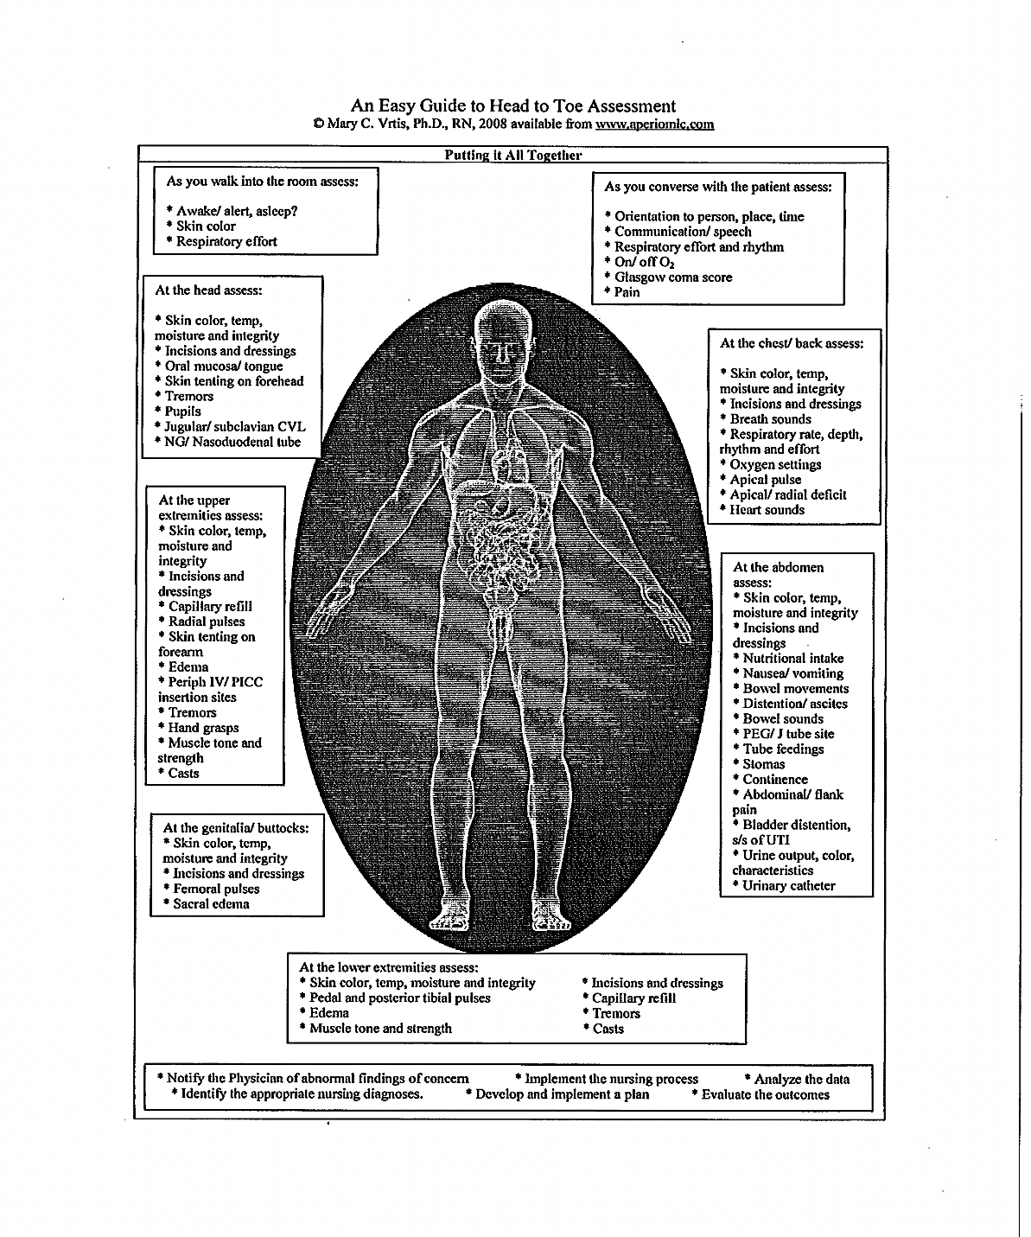

Slide 10
Let’s watch a video
Focused physical Assessment Video

Slide 11
Wheeze - Expiratory Auscultation CourseID:202

Slide 12
ANY QUESTIONS?

Slide 13
References
Diversified Healthcare Consulting – Documenting Clinical Care
Potter & Perry (2009) Fundamentals of Nursing. 7th ed. Mosby
YouTube videos

